Slide 1
Environmental Sustainability
INFCOM-3 Side Event
(15 – 19 April 2024)
Shannon Kaya
Environmental Sustainability Focal Point
15 April 2024

Slide 2
Contents
Context
Background
FP for EnvS → SG-EnvS
Accomplishments
International Survey
TECO Panel Discussion
International Virtual Workshop
MTWE Panel Discussion
Documentation
Next Steps

Slide 3
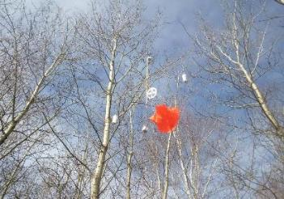
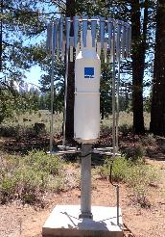
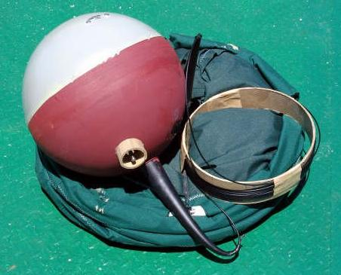
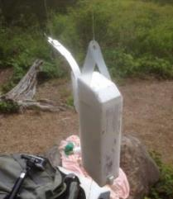
Observing systems and operations have environmental impacts…
National observing networks for weather and climate are designed and operated to meet domestic and international requirements within resource and feasibility constraints
Associated environmental impacts are acknowledged, but have not driven network design or procurement
Some of the greater environmentally challenging methods of observation are foundational in the production of critical weather and climate information
Examples of observation methods, operational practices with environmental impacts
Radiosondes and ozonesondes
Marine drifter buoys
Oil/antifreeze mixtures used in precipitation gauges
Waste transportation and disposal
Use of mercury / Minamata convention
Site decommissioning
Photo credit: John Buchanan
Photo credit: GEONOR
Photo credit: J. Anderson
Photo credit: J. Anderson
Photo credit: Global Drifter Program
Photo credit: John Buchanan
…which have generally been accepted to meet the data requirements of users, applications, and services

Slide 4
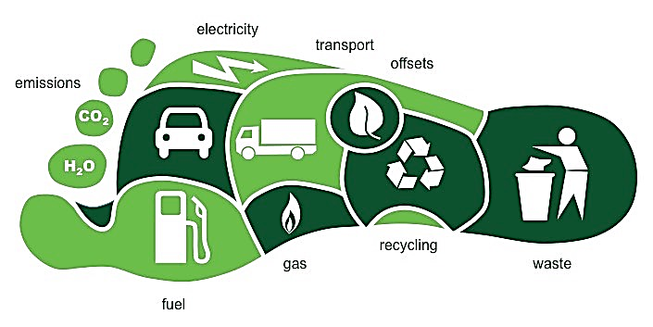
Organizations around the world are shifting to "greener" policies and practices…
GBON (WMO Global Basic Observing Network)
Establishes requirements for the spatial and temporal frequency of observations without consideration of environmental impacts when initially developed
CONSIDERATIONS:
Innovative tech solutions
Renewable energies
Improved waste management
Green fleet management
Reduced plastic use
Reduced carbon footprint
Public awareness campaigns
Green procurement
INFCOM (WMO Commission for Observation, Infrastructure, and Information Systems)​
Has resolved to update GBON requirements to address the environmental impact of observations
…and the WMO has recognized the environmental impact of observing systems and practices

Slide 5
The international Focal Point coordinates plans and activities to develop recommendations for WMO WIGOS regulatory material
Observation domains
Meteorological
Hydrological
Atmospheric chemistry
Marine
Advocacy theme
Meteorological
Hydrological
Atmospheric chemistry
Marine
Influence policy and operations to consider environmental sustainability in decision making process
Consider capacity development activities, incentive programs, training material and events
= CULTURE SHIFT → requires capacity development
DOMAINS
Technical theme
Understand environmental impacts of current observing systems and operations and explore mitigation options
Assess new or emerging technologies and practices to complement existing systems and processed while reducing environmental impacts
Articulate technical solutions in support of environmentally sustainable observation technologies, methods, processes, standards
Collaborate with vendors to explore new business models and grow a competitive market

Slide 6
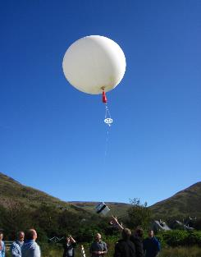
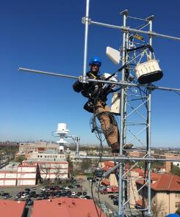
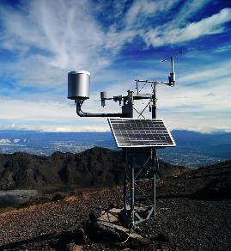
Observing systems and practices vary in degree of environmental impact and criticality to weather and climate services…
CATEGORY 1:
Infrastructure, sensors, instruments
Technological innovations needed
Challenge high (long term)
Value for climate/weather info high
◉ Ozonesondes
◉ Radiosondes
◉ Plastics
(e.g. drifter buoys)
Degree of environmental impact
Credit: AMOF
◉ Antifreeze/oil
Mercury
Credit: Azista Aerospace
Level of effort/challenge in finding environmentally sustainable solutions
◉ Waste management
Maintenance  Activities .
CATEGORY 2:
Practices, standards, operations
New processes needed
Challenge reasonable (short term)
Value for climate/weather info limited
◉ Packaging
Installation Work 
Credit: Campbell Scientific
Criticality of data products for weather and climate services
Credit: Windy.app
…presenting an opportunity to categorize challenges and focus on near term 'wins'

Slide 7
The Environmental Sustainability of Observing Systems and Methods initiative will evolve over many years...
PHASE 1: Meteorology & Marine
Panel discussion at TECO
Survey
data analysis + result sharing
Report on status at INFCOM-MG
Virtual international workshop
Report summarizing event findings & recommendations
Present at TECO 2024
2022
2023
2024
OCT
DEC
JAN
FEB
MAR
MAY
SEP
OCT
DEC
APR
SEP
DEC
International survey
responses closed
International workshop planning initiated
Engagement with Marine community at SOT-12
Met Tech World Expo presentations & panel
Present recommendations to INFCOM-3
Future activities TBD
(Phase 2)
PHASE 2: Hydrology & Atmospheric Chemistry TBD
…ensuring continuous improvements can be achieved for each observational domain

Slide 8
A 2022 WMO survey on environmental sustainability was conducted with clearly defined objectives
Scope: Gather information from National Meteorological and Hydrometric Services (NMHSs) regarding current, planned, and potential approaches to enhance the environmental sustainability of observations in meteorological, hydrological, atmospheric chemistry, and marine domains
Key Objectives
Demonstrate value of participation in development of environmental sustainability of observation recommendations
Benchmark international programs, practices, policies, and priorities
Identify and understand challenges, key impacts, and considerations from WMO members
Evaluate linkages with international standards (ISO 14001, LEED)
Develop an evidence base of current and prospective methods and technologies
Explore whether Members would be willing/able to participate in follow-up activities (e.g. drafting recommendations)
Gather ideas for innovation and incentive programs
Addressed current, planned, and potential activities to incorporate sustainability across the operational life cycle (network planning and design, procurement, siting and installation, operations and decommissioning)
The survey was distributed to 193 WMO Member States and Territories.
A total of 103 responses were received from 78 Members.

Slide 9
The WMO survey on environmental sustainability of weather and climate observations was organized across the network life cycle…
Weather and Climate Observing Network Life Cycle
PLANNING / PROCUREMENT
SITING / INSTALLATION
OPERATIONS
DECOMMISSIONING
New technologies
Location considerations
Deployment optimization
Green procurement practices
Power generation
Building certifications
ISO certifications
Materials (infrastructure)
Fleet management
Materials (instruments and disposables)
Processes / standards
Waste transport and disposal
Practices and regulations
Waste transport and disposal
Legislation, regulations, policies
* Note that not all info is within scope for the recommendations that will be developed, but will provide good baseline info for the report so will be included in the survey
Primary challenges to implementing more environmentally sustainable processes, procedures, standards?
Priorities around environmental sustainability (new technologies, fleet management, policy development, power generation, waste management, decommissioning practices, environmental assessments, other?)
Suggestions for focused areas of improvement on environmental sustainability of observations
…and aimed to gather ideas and perspectives related to improvement areas and key challenges faced today

Slide 10
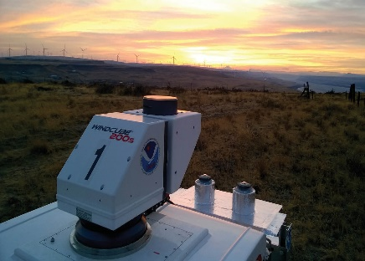
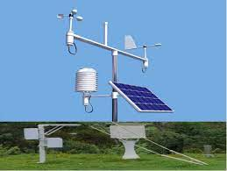
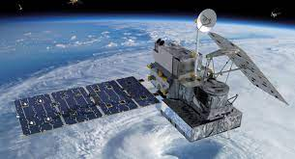
Environmental sustainability is already a key factor in network planning for many respondents…
Capacity development and outreach (5%)
Complementary observations (9%)
Greener business practices (29%)
Improving tech/telecom infrastructure (26%)
Greening existing methods/systems (17%)
Areas of investigation reported for meteorological domain
Alternative data sources (12%)
…with approximately 60% indicating that they are actively investigating new technologies to reduce environmental impacts

Slide 11
Environmental sustainability is becoming an increasingly important consideration in procurement…
Potential for Members to promote and advocate for environmental considerations in their procurement processes
25% of respondents consider environmental accreditations of vendors as a requirement in their procurement process
ISO 14001 (Environmental Management)
ISO 50001 (Energy Management)
LEED (Leadership in Energy and Environmental Design)
Not applicable or do not know (9%)
Very important (27%)
Not at all important (4%)
Of little importance (25%)
Somewhat important (35%)
Member ratings of the importance of sustainability criteria in their organization’s procurement process
…with over 60% of respondents indicating it is somewhat or very important; however, it is not yet universally accepted as a priority

Slide 12
Environmental impacts are broadly considered when selecting observing system locations, construction materials, and infrastructure…
Percentage of observing system installations using renewable energy sources
Many WMO Members are taking active steps to reduce their environmental impacts
Key mechanism: installations incorporating renewable energy sources
Low uptake of environmental management accreditations by Members
13% of respondents verified having ISO 14001 accreditation
Cost may present a barrier
More than 61% of installations (25%)
Less than 10% of installations (28%)
41% to 60% of installations (12%)
Do not know or not applicable (9%)
11% to 40% of installations (25%)
…with over 65% of respondents indicating that environmental impact criteria are somewhat or very important in these areas

Slide 13
Many organizations have already taken steps to improve the environmental sustainability of their observing system operations…
Use of renewable energy
Potential areas for improvement
Monitoring of physical waste
Not monitored by 75% of responding organizations
Greener vehicle fleets
Over 85% of respondent fleets use gasoline and diesel
50% had no plans to transition to more sustainable options
Reducing emissions and costs by reducing number of field visits
Enhancing capacity for remote access by improving telecommunications capabilities
Transitioning to more sustainable lofting gas generation for upper air observations
Recovery of radiosondes and ozonesondes
…highlighting the nascent commitment of WMO Members to reducing their environmental impacts

Slide 14
WMO Member respondents are largely compliant with regulations for hazardous materials when decommissioning installations…
Respondents noted a range of practices for decommissioning and phasing out hazardous materials
Results suggest that decommissioning of observing system installations to pre-construction status is an area for development
More than half of responding organizations do not have formalized decommissioning procedures
Compliance with regulations defining hazardous materials and how to decommission them properly
Organizations on track to phasing out mercury from all observing systems
…and are well on track toward phasing out mercury from observing systems in accordance with the Minamata Convention on Mercury

Slide 15
Members provided perspective on priority areas for advancement and implementation challenges…
Opportunities
01
02
03
Policy development is the top Member priority area for advancement
Reinforces value of WMO leadership
Policy development
Innovative technology assessment, implementation
Changing business practices
Challenges
01
02
03
Results highlight need for ongoing engagement with industry
Barrier to implementation for Least Developed Countries
Cost prohibitive
Availability of viable solutions
Operational feasibility
… with many committing to further engagement toward solutions

Slide 16
The survey results framed how environmentally sustainable practices are viewed and prioritized by Members…
Example: the cost and availability of helium are affecting many WMO Members
Procurement
Network Planning
Observing system installations and infrastructure
Environmental sustainability is becoming an increasingly important consideration in procurement processes
Some Members consider the environmental accreditations of vendors
Environmental impact criteria are widely considered when selecting observing system locations, construction materials, and infrastructure
Many Members are using renewable energy sources in installations
34%
Environmental sustainability is already a key factor in network planning for many respondents
Many Members are actively investigating new technologies to reduce environmental impacts
Have replaced or are replacing helium with hydrogen gas for upper air, atmospheric chemistry obs
14%
Use a chemical alkaline process for hydrogen generation
15%
Use or are exploring alternative hydrogen production systems
…establishing a baseline for assessing progress and identifying gap areas

Slide 17
The WMO initiative on environmental sustainability of observing systems and methods will advance recommendations…
The transition to more environmentally sustainable observing systems and methods is challenged by:
The 2022 Survey demonstrated that organizations are taking positive steps toward sustainability, but crucial gaps remain
The criticality of observations via established systems/methods
Financial and operational feasibility considerations
The requirement for clear guidance from WMO to Members and the vendor community to inform implementation
Credit: Digi International
Our commitment aligns with the WMO’s vision for environmentally sustainable observing systems within GBON and WIGOS
Together, Members can actively work toward a more environmentally responsible future in all observational domains
…to mitigate challenges experienced by Members

Slide 18
The WMO Virtual Workshop on Environmental Sustainability of Observing Systems and Methods…
Day 1 | September 12th, 2023
Observing Systems
Day 2 | September 13th, 2023
Policies, practices, and standards
Target Audience
WMO Members
Vendor community
Any other interested parties
Number of international registrations
Objectives and Purpose | Share information among initiative stakeholders (NMHSs, industry) via presentations and focused discussions to establish common ground/baseline Present and discuss key outcomes from the survey and identify remaining gaps
408
Participant Registration Demographics:
Goal/ Outcome | Develop recommendations on a path forward to Members, the vendor community, and WMO
16 presentations + 6 breakout sessions
…provided an international forum for discussion and collaboration to advance recommendations

Slide 19
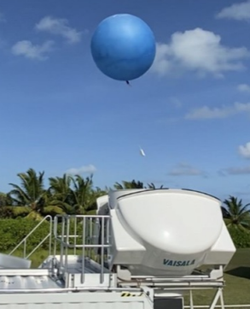
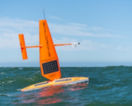
A holistic, end-to-end approach to observing systems can identify avenues to enhance environmental sustainability…
Core issue: maintaining system capabilities and essential data collection while reducing environmental impacts
Key approach: life cycle assessment
How we design observing systems
Considering the full life cycle of weather and climate observing systems
Thinking beyond technologies and factoring in design, manufacturing, installation, operation, maintenance, and decommissioning phases
Tiered networks
Re-thinking specifications
Flexibility via tech choices, autonomous systems
What we procure
Extending life cycles, reducing maintenance
Sustainable materials
How we operate
Renewable energy sources
Mitigating risks to ecosystems
Minimizing on-site presence
Credit: Renae Baker
Credit: Olivier Desprez de Gésincourt
Credit: Dawn Petraitis
…opening the door for innovation and collaboration to advance viable solutions
Notes:
Alternative footer text: “…which must be aligned with operational sustainability to ensure long-term viability.”

Slide 20
International guidance, standards, and best practices are needed for coordinated advancement…
Establish baselines and track progress
International surveys Concept of voluntary “opportunity scans” for environmental sustainability within organizations
Top-down
WMO
SOFF
Int’l policy
Members NMHSs Vendors
Bottom-up
Set clear expectations and incentives for vendors
Define environmental sustainability requirements and make them worthwhile to implement
Advancement via a combination of top-down and bottom-up processes
Remove barriers to implementation for Members
Acknowledge and address unique challenges faced by different Regions, Members
Collaboration is key
Recurring theme
Transform “the norm”
Build environmental sustainability into funding, procurement models
“The ultimate value-multiplier”
…leveraging expertise and lessons learned at the national and organizational levels

Slide 21
Through the presentations and discussions at the workshop, recurring themes emerged…
Working in alignment with stakeholders, industry
Identify opportunities to pool resources (e.g. funding, knowledge, development, testing) to achieve efficiencies
Collaboration
Encourage new ways of thinking, approaches to observing system and policy challenges
Active engagement with industry, academia
Innovation
Ongoing engagement, education, and capacity development
Targeted engagement of Regions, young people
Support for LDCs beyond infrastructure provision
Outreach
Necessity of quantitative assessments to frame impacts of infrastructure/data (e.g. on NWP) relative to environmental impacts
Enable informed decision-making (e.g. cost-benefit analyses)
Evidence
…providing guideposts for progress as the initiative moves to put forward recommendations

Slide 22
A 2022 TECO panel discussion on environmental sustainability had several key takeaways and recommendations
Some of the key takeaways from the panel discussion include:
October 2022 in Paris, France
Innovation
Commitment
Data impact
Data quality
Cost barriers
Communication
Discussion on possibilities to enhance environmental sustainability produced the following suggestions:
Business framework
International standards
Evaluation criteria
Life cycle management
E.g., adoption of ISO 14001 for NMHS' and vendors
Standards for common processes could reduce waste during life cycle replacement
Manufacturing principles for environmentally sustainable methods/instruments
Goal to extend the life of usable instruments, parts, reduce maintenance, etc.
Recording available: Meteorological Technology World Expo | TECO Conference Programme 2022

Slide 23
The Meteorological Technology World Expo (MTWE) hosted a forum on advancing the environmental sustainability of observing systems & methods
A venue for industry representatives to:
showcase the latest developments in sustainable weather and climate observing systems and methods
engage with each other and the broader user community
share and discuss opportunities and challenges
October 2023 in Geneva, Switzerland
Primary Focus:
Meteorological (surface, upper air) and marine observational domains
Goal: enhance sustainable outcomes
Key ideas and sustainable initiatives:
Instrument material choice
Low maintenance infrastructure
Renewable energy sources
Recycling programs
Take-aways from the panel discussion:
Collaboration (NMHSs/vendors)
Network optimization
Operational life cycle
Informed procurement
Notes:
MTWE: A venue for industry representatives to showcase the latest developments in sustainable weather and climate observing systems and methods, and to engage with each other and the broader user community to share and discuss opportunities and challenges to enhance sustainable outcomes.
Instrument material choice: emphasis was placed on the environmental impact of radiosonde observations. Innovations included reducing Styrofoam and plastic contents with the use of biodegradable covers and insulation, and cellulose-based BioTwine unwinder twine. It was noted that in some cases, intercomparisons have shown a reduction in plastic content by more than 60% with no significant performance outcomes relative to standard models.
Low maintenance infrastructure: proposals included optimizing site visits, maintenance schedules, and allowing for flexible deployment. Suggestions included the democratization of weather radars, with the removal of fixed infrastructure by shifting towards portable solid-state instrumentation.
Renewable energy sources: the use of solar power and other energy-efficient platforms can increase operational efficiency and minimize waste. Assessments of how solar power changes by season can be used to maximize renewable energy value.
Recycling programs: there was recognition that efforts to repair and recalibrate sensors to minimize equipment waste should be prioritized among organizations. Additional potential exists to avoid single-use sensors through pre- and post-field calibration.
Collaboration among NMHSs and the vendor community: specified standards are required for vendors to maximize environmentally sustainable approaches. There is also a strong need to continuously seek synergies among observational domains.
Network optimization: it is important from a planning perspective to mitigate network redundancy. This can be achieved through tiered networks, and strategic data collection (e.g., shared platforms).
Operational life cycle considerations: there is high value for organizations to invest in robust systems with longer operational lifetimes. The total cost of ownership must consider all factors, including site decommissioning.
Informed procurement: the use of Requests for Information (RFIs) before Requests for Proposal (RFPs) has significant impacts. This increases awareness of the availability and feasibility of possible options, leading to improved specifications and more efficient procurement processes.

Slide 24
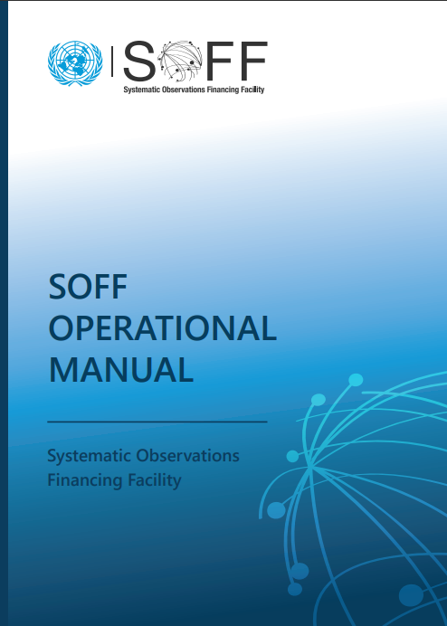
TT-GBON Documentation
As a member of the Task Team on GBON Implementation (TT-GBON), consideration for environmental sustainability was added to the SOFF technical specifications for both surface and upper air observing networks.
The WMO Commission for Observation, Infrastructure and Information Systems (INFCOM) requested, through the Resolution 4 (INFCOM-1), that the future development of GBON addresses the environmental impact of observing technologies as Members advance towards GBON compliance. The goal of this work is to deliver recommendations for amendments to WIGOS regulatory material that will result in more environmentally sustainable weather and climate observing systems, technologies and practices.
The recommendations related to environmental sustainability are to be considered by SOFF peer advisors in the development of the instrument specifications for the procurement of the measurement equipment to meet the GBON requirements. These recommendations will evolve and become more detailed over time as new information is analysed and translated into requirements.

Slide 25
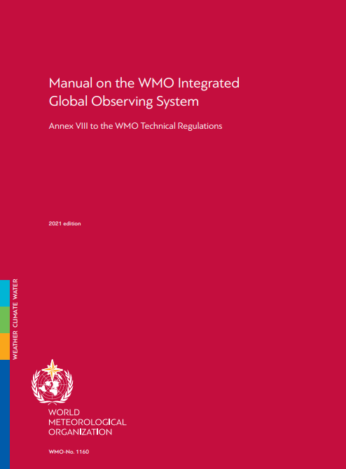
WIGOS Manual
During WMO EC-76 a proposed decision was adopted to revise the WIGOS manual (WMO-No.1160) and the WIGOS manual ANNEX to introduce a new observing network design principle:
13. Advancing environmental sustainability
The environmental impacts of observing networks should be considered in their design and operation. Advancements in the environmental sustainability of networks should be promoted where viable solutions are available that meet user requirements.
This establishes the foundation for future Statements of Guidance to ensure that environmentally sustainable methods of observation are prioritized.
Similar text highlighting environmental sustainability was also added to the GBON Guide

Slide 26
Active wide-scale participation is key to progress towards sustainable observing systems…
Summary
Next steps:
The WMO Environmental Sustainability initiative will advance recommendations to mitigate challenges
The transition to more environmentally sustainable observing systems and methods is challenged by:
The criticality of observations via established systems/methods
Financial and operational feasibility considerations
The requirement for clear guidance from WMO to Members and the vendor community to inform implementation
Results demonstrate that many organizations are taking positive steps toward sustainability, but gaps remain
Preparation of recommendations for WMO INFCOM consideration​
(Spring 2024)
Participation on WMO discussions for continuous advocacy and communication with members
Potential for a follow-up survey in 2025 to assess impacts of advocacy via this initiative
…and the continued success of this initiative will be led by the SG-EnvS

Slide 27
An event will be hosted at TECO 2024 in Vienna, Austria…
Conference Theme: Measurements and new technologies for WMO priority initiatives
September 23-26, 2024
Session on the Environmental sustainability of observing systems:
Innovations in measurement technologies and methods reducing environmental impact
Life-cycle assessments of instruments and observing systems
Regulations, guidance, and incentives for environmentally sustainable approaches
Use of environmentally friendly materials
Best practices related the procurement, management and operations of observing systems

Slide 28
Thank you
^{wmo.int}

